Slide 1

RAK3172 to LPS8N
LoRaWAN Module to LoRaWAN Gateway Testing

Slide 2
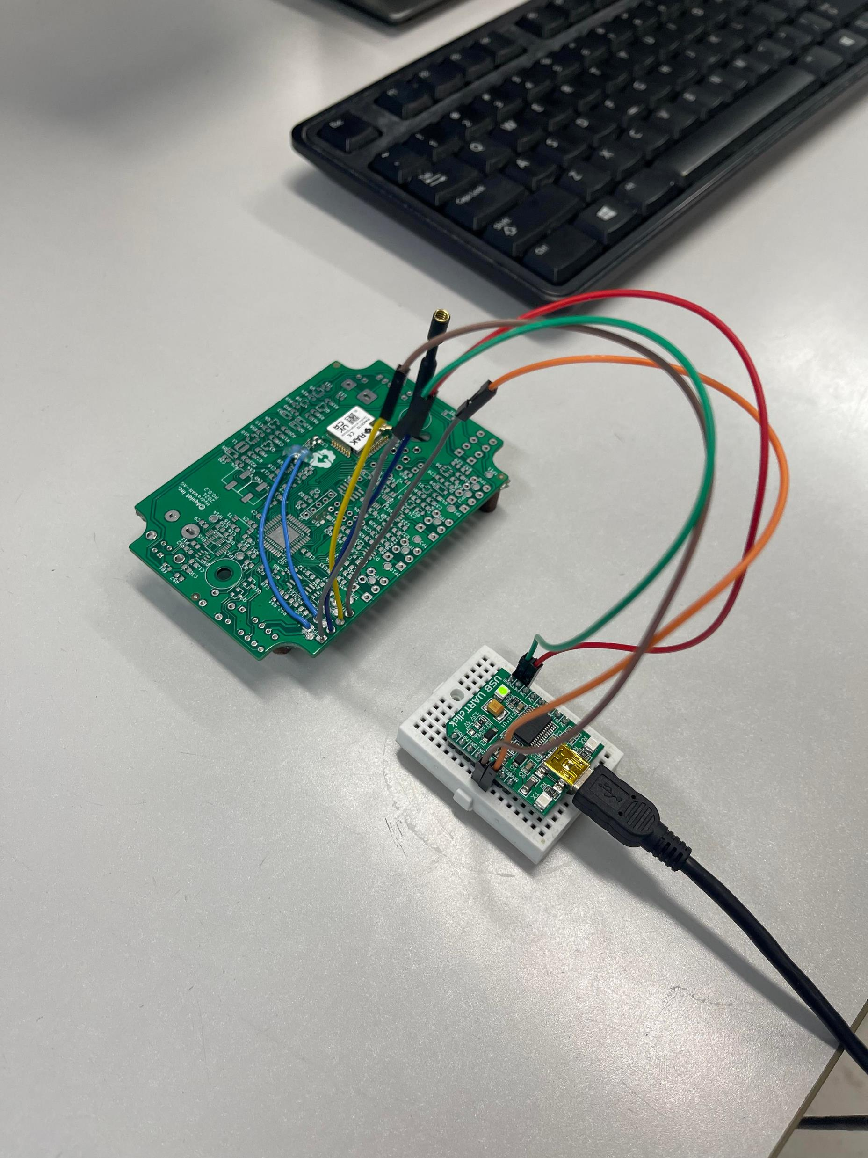
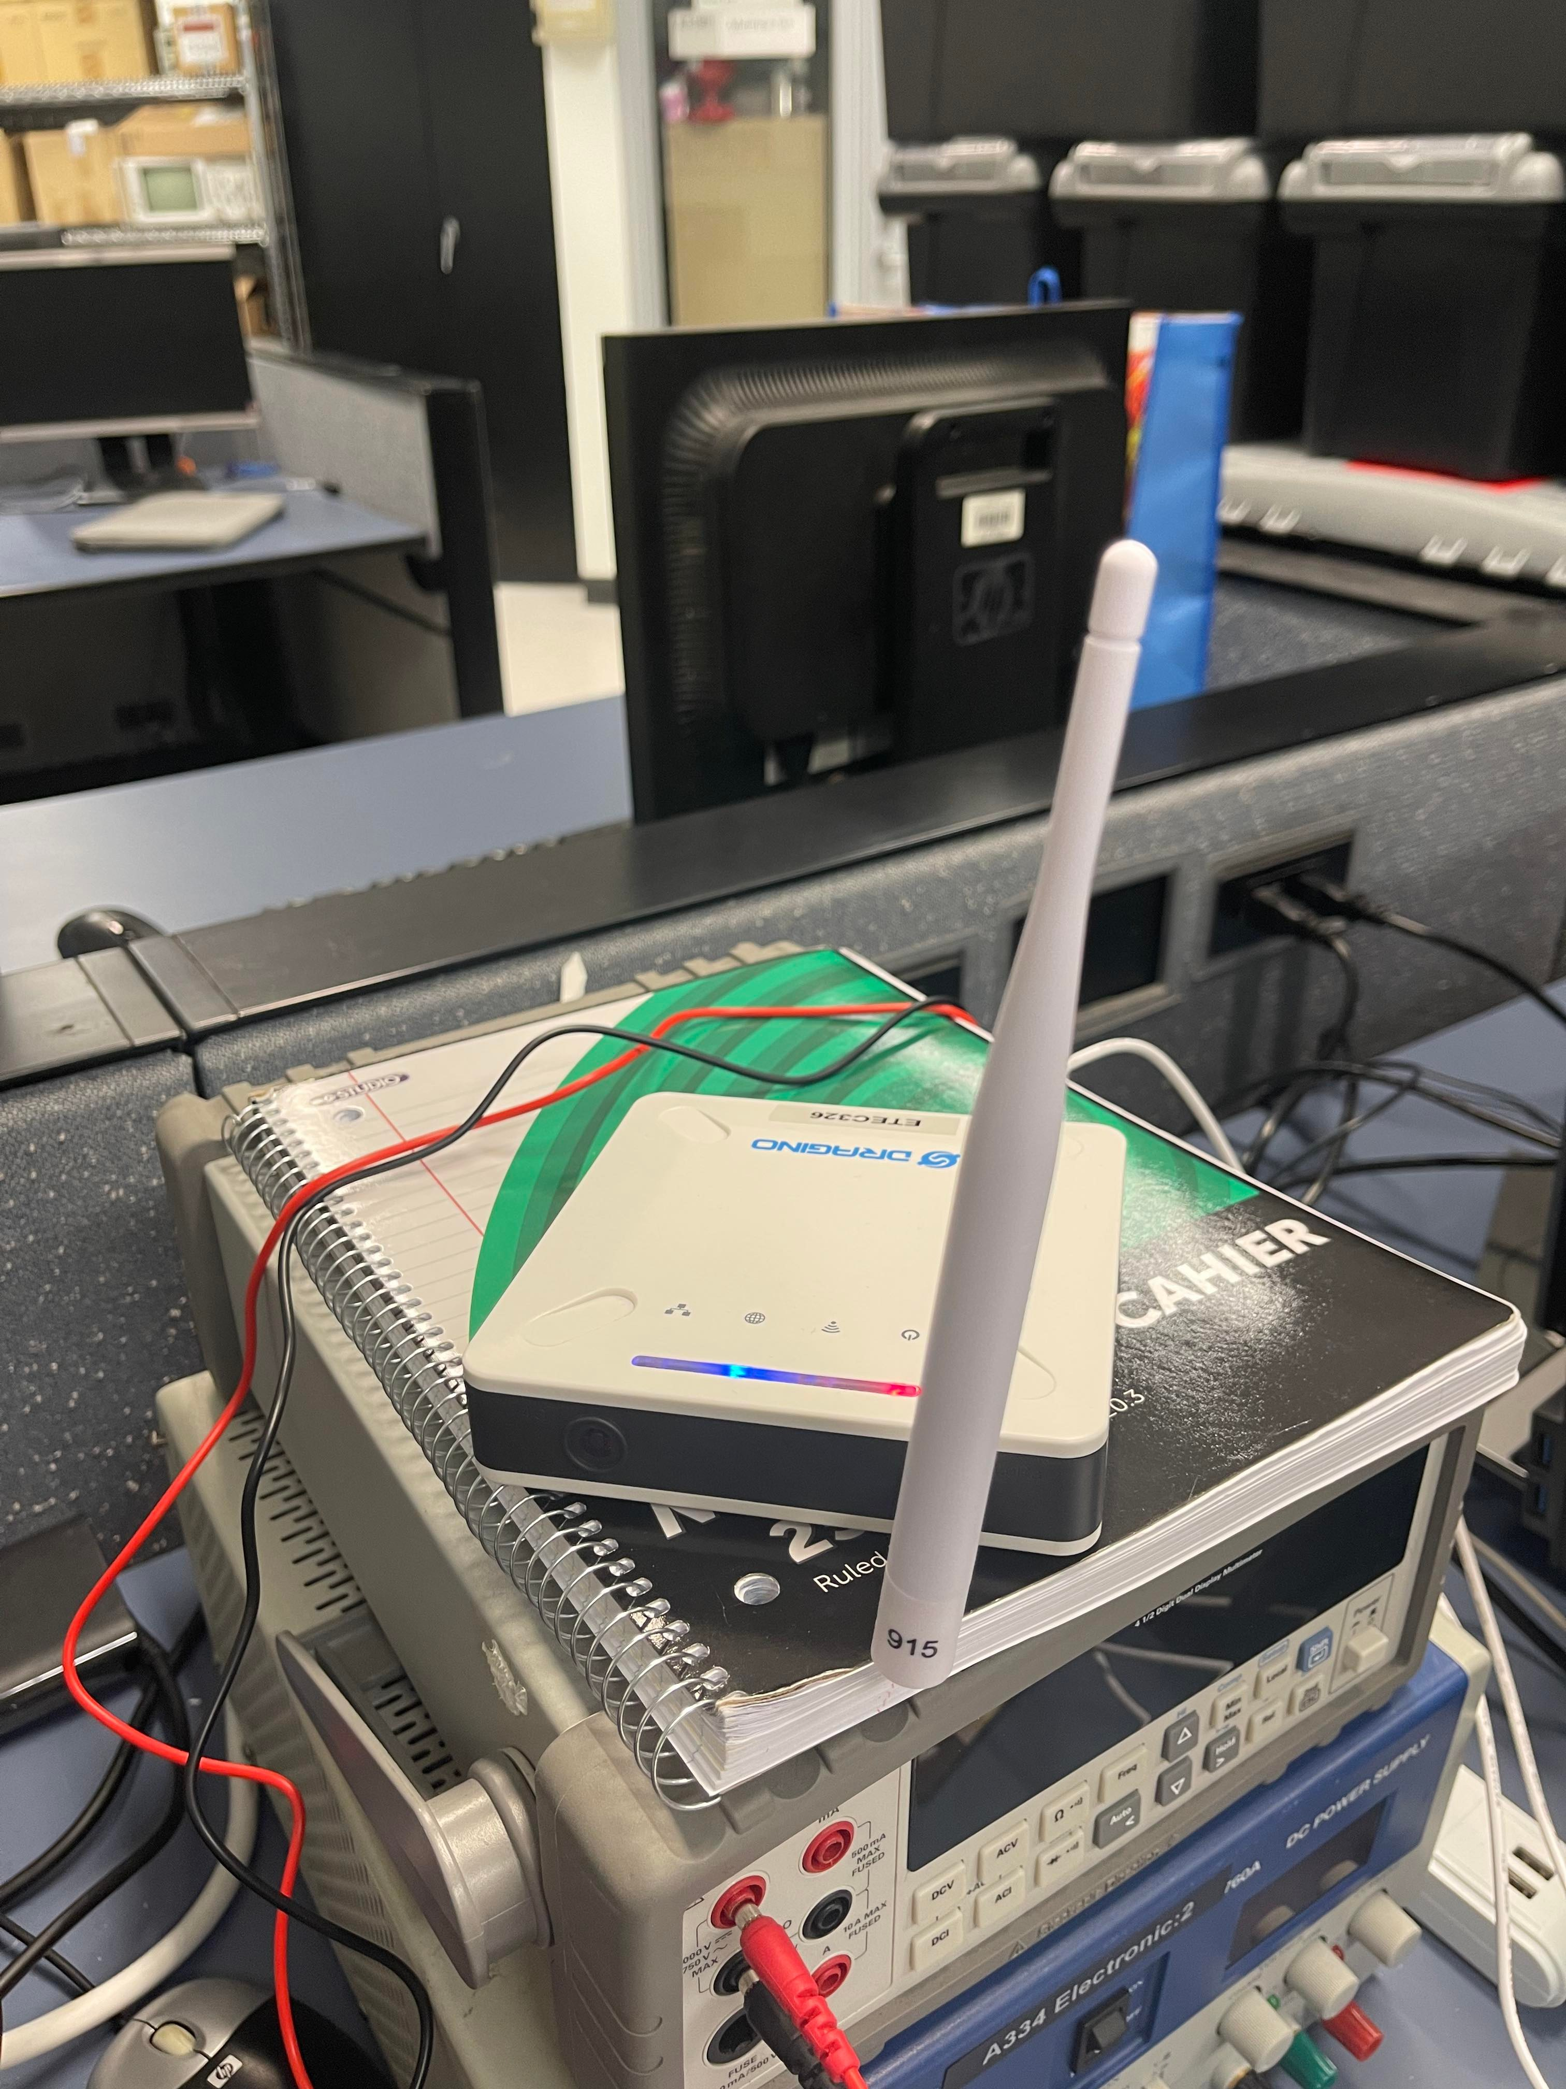
Setup and Location
RAK3172 in A3-56
LPS8N in A3-34

Slide 3
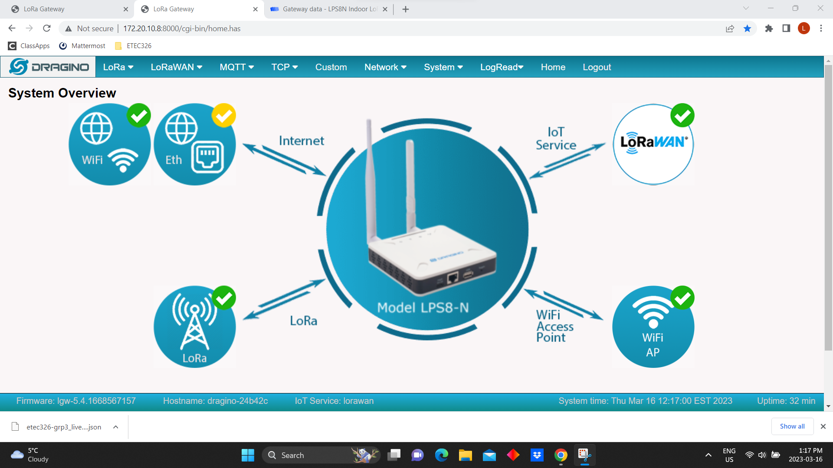

Slide 4
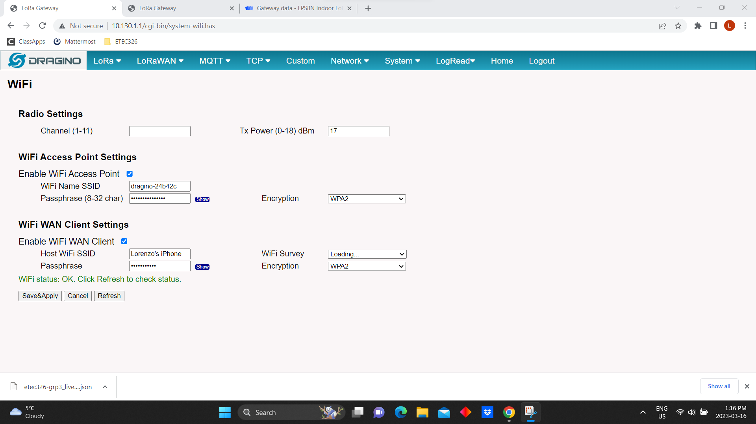

Slide 5
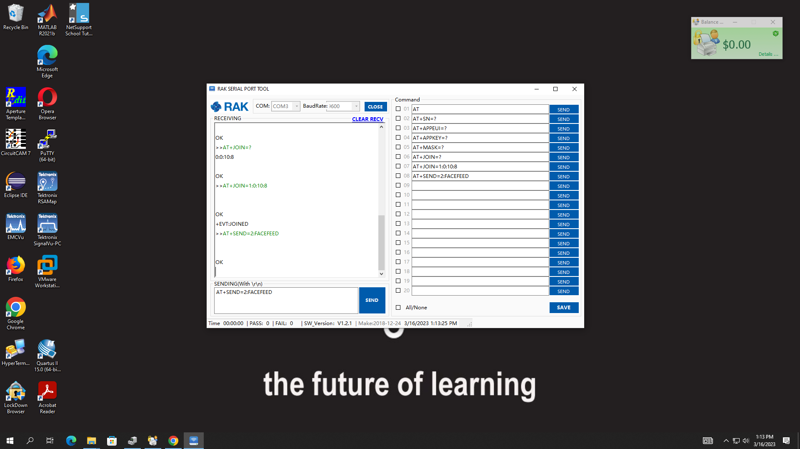

Slide 6
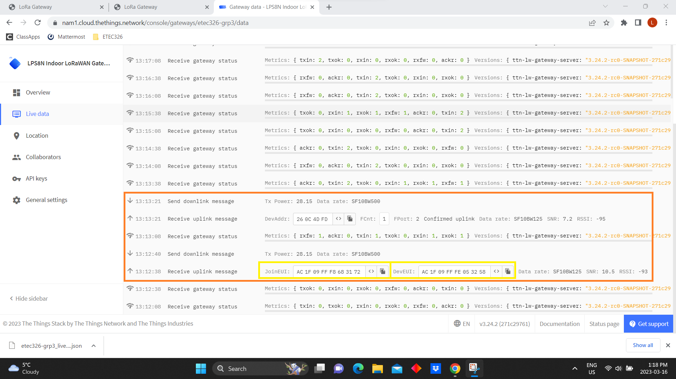

Slide 7
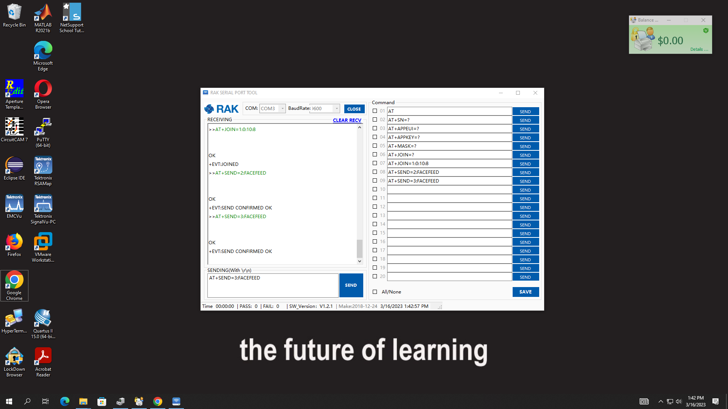

Slide 8
